Slide 1

Dhole Patil Education Society
Dhole Patil College of Engineering, Pune
Subject – Basic Electrical Engineering
First Year Engineering Semester – I
Unit II : Electromagnetism
Magnetic Circuit
Electromagnetic Induction

Slide 2
Lecture Planning
Magnetic Circuits
Concept of flux density, field strength, permeability, MMF, reluctance, their units, and relationships. (Theory) (definitions, relation between Flux, mmf and reluctance)
Simple series magnetic circuit (one magnetic material along with an air gap), comparison of electric and magnetic circuit. (Theory)
Numericals: To find flux, flux density, field strength, MMF, reluctance (Simple series magnetic circuit with and without air gap)
Electromagnetic Induction
Faradays Laws of electromagnetic induction, dynamically induced emf ( No numerical), Fleming’s right-hand rule, Statically (Self and mutually) Induced EMF (Theory)
Self and mutual inductance, derivation of coefficient of coupling of magnetically coupled two coils. Derivation for energy stored in magnetic field
Numericals: To find self and mutually induced emf, self-inductance, Mutual inductance, Coefficient of coupling, energy stored.

Slide 3
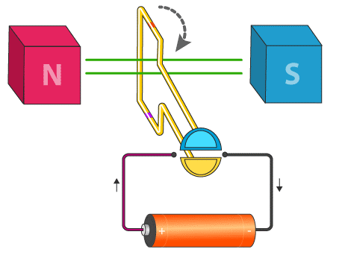
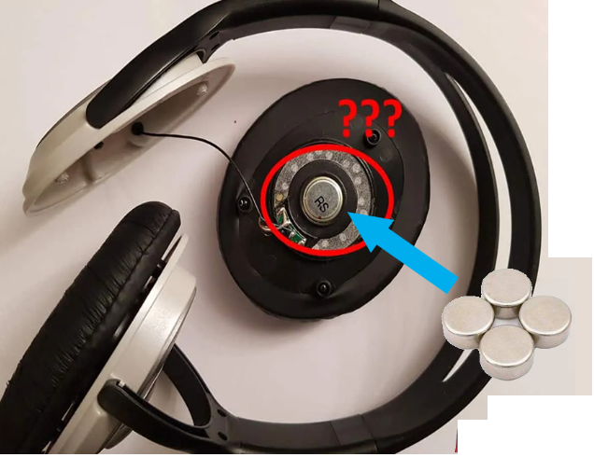
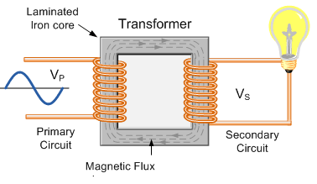
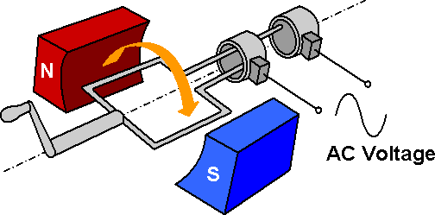
Applications (Magic of Magnetism)
Laptops & Computers
Robotics & Automation (Sensors & Actuators)
Maglev trains
Doorbells
(MRI) machines
Credit cards
Vacuum cleaners
Blenders
Washing machines
Hard drive
Relays
Motor
Headphone
Transformer
Generator

Slide 4
Terms related with Magnetic circuit
Magnetic Flux density (B)
Magnetic Field strength (H)
For straight conductor
For coil
Permeability (µ)
Absolute Permeability of free space /material
Relative Permeability
Magnetomotive Force (MMF)
Reluctance and Permeance
Part A: Magnetic circuit
Laws of Magnetism
Magnetic field
Magnetic lines of force and their properties
Magnetic flux
Flux due to current carrying conductor
Cross and dot conductor
Right hand thumb rule
Flemings left hand Rule

Slide 5
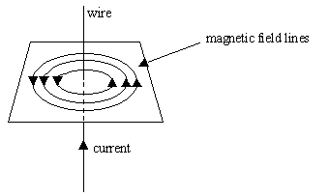
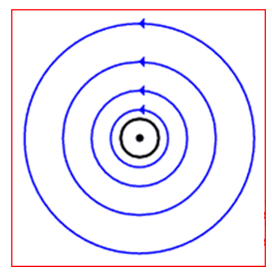
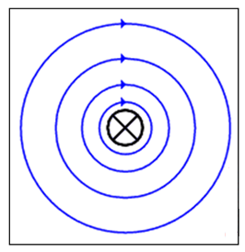
If an electric current is passed through a wire, a weak magnetic field is produced.
Wire
Field lines can be followed and plotted using a plotting compass.
Magnetic field lines
The ‘dot’ represents the current flowing towards the observer (as shown in the diagram above)
Current (conventional)
The ‘cross’ represents the current flowing away from the observer (the field direction is reversed).
Field features:
The magnetic field lines are circles.
The field is strongest closer to the wire.
Increasing the current increases the field strength.

Slide 6
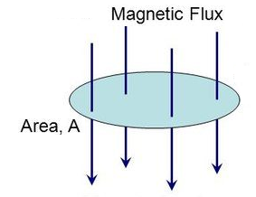
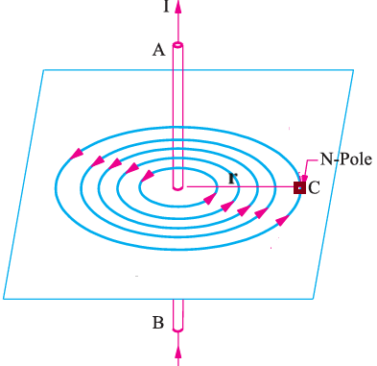
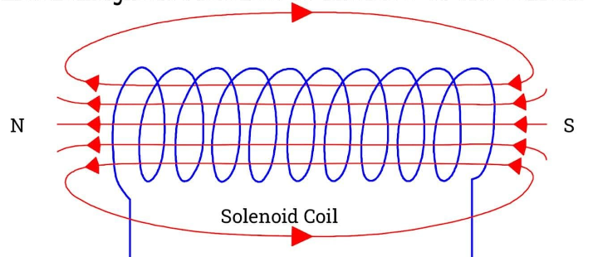

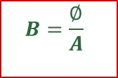


Terms related to magnetic circuits
Flux Density :
It is defined as 'The flux per unit area in a plane at right angles to the flux is known as 'flux density'.
$$B=\frac{∅}{A}$$
Unit -
$$\frac{Weber}{m^{2}}$$
Magnetic Field Strength
For Straight Conductor
For Coil/ solenoid
It is defined as 'the force experienced by a unit N-pole (i.e. N-pole with 1 Wb of pole strength), when placed at any point in a magnetic field is known as magnetic field strength at that point
l
With N turns
$$H=\frac{I}{2πr} \frac{Amp }{mtr}$$
$$H=\frac{NI}{l} \frac{Amp Turns }{mtr}$$

Slide 7
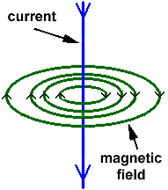
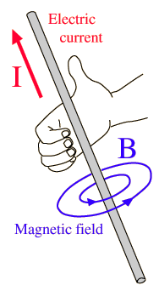
Rules to deicide the direction of the magnetic field
A static distribution of charges produces an electric field
Charges in motion (an electrical current) produce a magnetic field
The direction of the magnetic field is determined with the current associated with it & there are two rules for it :
1) Right Hand thumb rule : 2) Cork screw rule :
Imagine gripping the wire with your right hand so that your thumb points in the current direction (conventional). Your fingers then point in the same direction as the field lines.

Slide 8
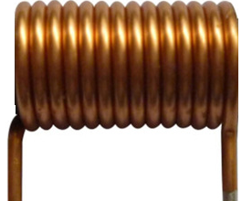
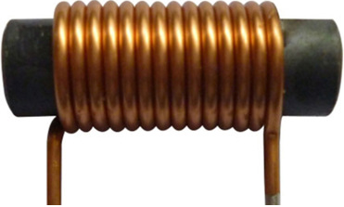





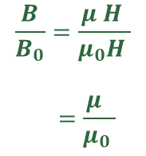



Permeability
It is defined as ability or ease with which the magnetic flux gets established in a given medium.
Air Cored Coil
Iron Cored Coil
$$\frac{B}{B_{0}}=\frac{μ H }{μ_{0}H }$$
$$=\frac{μ }{μ_{0} }$$
$$=μ_{r}$$
$$B_{0} α H$$
$$B α H$$
$$B_{0}=μ H=μ_{0}H$$
$$B=μ H$$
Absolute Permeability
of free space /air/ vaccum
Absolute Permeability of magnetic material
Relative
Permeability
$$μ_{0}=4πx{10}^{−7} \frac{H}{m}$$
$μ=μ_{0}μ_{r}$ $\frac{H}{m}$
$$μ_{r}$$

Slide 9
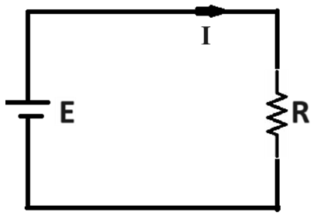

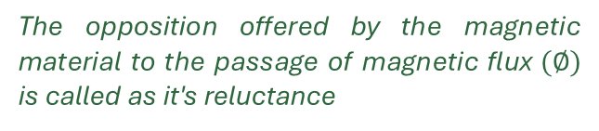












Relation between MMF, Reluctance and Flux
Magnetic Circuit
Electric Circuit
l
$$∅=\frac{MMF (F)}{Reluctance (S)}$$
$$I=\frac{E}{R}$$
$$F=∅S$$
$$μ_{r}$$
$$Magnetomotive Force,$$
$$Reluctance$$
$$Permeance$$
It is the force required to produce or create flux in a magnetic circuit.
The opposition offered by the magnetic material to the passage of magnetic flux$(∅)$ is called as it's reluctance
It is reciprocal of reluctance and is defined as ease or readiness with which magnetic flux gets developed
$$S=\frac{l}{μ_{0}μ_{r}a}$$
$$=\frac{NI}{∅}$$
$$\frac{Amp Turn}{Weber}$$
$$=\frac{1}{S}$$
$$\frac{Weber}{Amp Turn}$$
$$F=NI=∅ S Amp Turn$$

Slide 10
Comparison between Magnetic and Electric Circuit
Magnetic Circuit | Electric Circuit
List Similarities
F, ϕ, S, F=ϕ S, S=, Permeance, …. | E, I, R, E=IR, R=, G, ….
List Dissimilarities
Flow of current & flux set up, Energy Required, Insulation provision

Slide 11
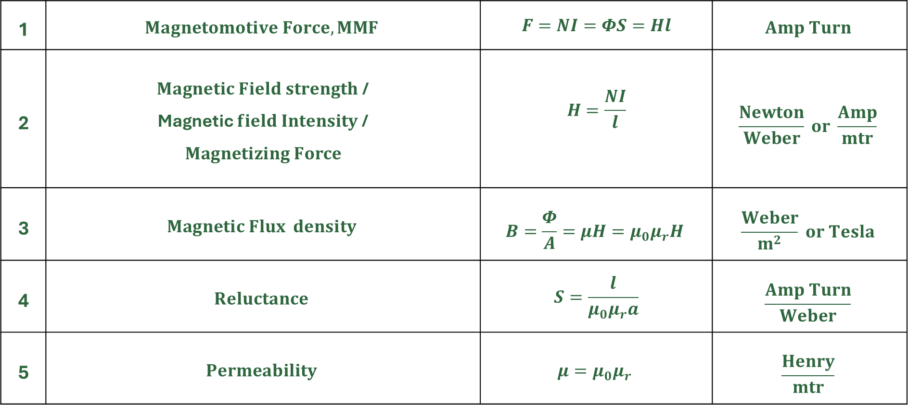
Formulae :
1 | $$Magnetomotive Force, MMF$$ | $$F=NI=ΦS=Hl$$ | $$Amp Turn$$
2 | $Magnetic Field strength$/ Magnetic $field Intensity$ / $$Magnetizing Force$$ | $$H=\frac{NI}{l}$$ | $$\frac{Newton}{Weber} or \frac{Amp}{mtr}$$
3 | $$Magnetic Flux density$$ | $$B=\frac{Φ}{A}=μH=μ_{0}μ_{r}H$$ | $$\frac{Weber}{m^{2}} or Tesla$$
4 | $$Reluctance$$ | $$S=\frac{l}{μ_{0}μ_{r}a}$$ | $$\frac{Amp Turn}{Weber}$$
5 | $$Permeability$$ | $$μ={μ_{0}μ}_{r}$$ | $$\frac{Henry}{mtr}$$

Slide 12
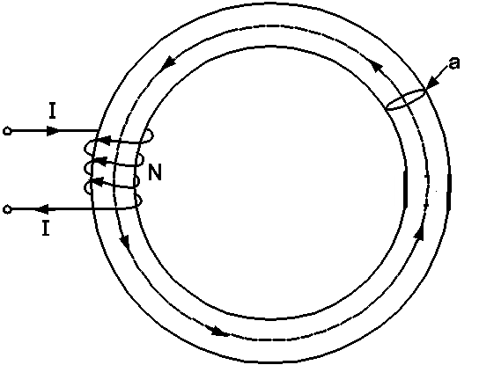
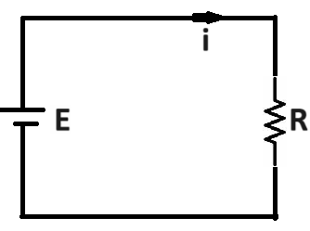
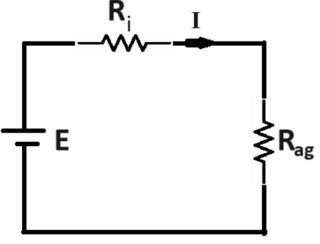








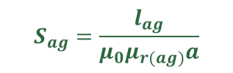
Series Magnetic circuit with and without air gap
$$F=NI$$
$$H=\frac{NI}{l}$$
$$I=\frac{E}{R}$$
$$S=\frac{l}{μ_{0}μ_{r}a}$$
ϕ
$$∅=\frac{NI}{S}$$
$$S_{i}=\frac{l_{i}}{μ_{0}μ_{r(i)}a}$$
ϕ_{ag}
$$S_{ag}=\frac{l_{ag}}{μ_{0}μ_{r(ag)}a}$$
ϕ
$$\text{∅}={\text{∅}}_{ag}=\frac{NI}{S_{i}+S_{ag}}$$
$$I=\frac{E}{R_{i}+R_{ag}}$$

Slide 13
Electromagnetic Induction
Faradays Laws of Electromagnetic Induction
Dynamically Induced EMF
Flemings Right Hand Rule
Statically Induced EMF
Self Induced EMF
Mutually Induced EMF
Self and Mutual Inductance
Coefficient of Coupling
Energy stored in Magnetic Field
Part B:

Slide 14
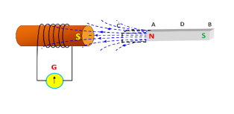
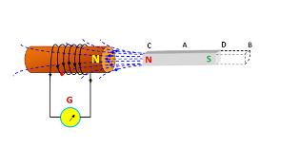


Faradays Laws of Electromagnetic Induction:
First Law: Whenever the magnetic flux linking with a conductor or a coil changes, an emf gets induced in it.
Second Law: The magnitude of EMF induced in a conductor or coil is directly proportional to the rate of change of flux linkages.
Φ₁
$$e=N\frac{d∅}{dt}$$
Φ₂
volt
$$e=−N\frac{d∅}{dt}$$
volt
(Lenz’s Law)

Slide 15
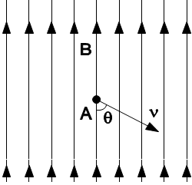
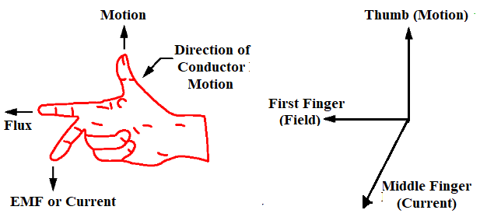
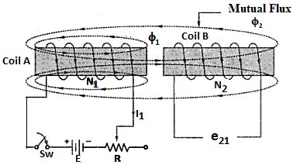
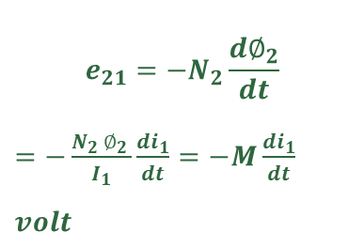


Dynamically Induced EMF
Statically Induced EMF
1) Self Induced EMF
$e_{s}=−L\frac{di}{dt}$ $volt$
$$e_{D}=Blv sinθ volt$$
e_{s}
Flemings right hand rule
2) Mutually Induced EMF
$$e_{21}=−N_{2}\frac{{d∅}_{2}}{dt}$$
$=−\frac{N_{2 }∅_{2 }}{I_{1}}\frac{{di}_{1}}{dt}=−M\frac{{di}_{1}}{dt}$ $volt$

Slide 16






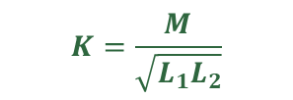


Self and Mutual Inductance
Coefficient of Coupling
M
Definitions
Factors affecting value of L and M
L₁
L₂
$$L=\frac{N∅}{I}=\frac{N^{2}}{S}=\frac{N^{2}μ_{0}μ_{r}a}{l}$$
Henry
$$M=\frac{N_{2}∅_{2}}{I_{1}}=\frac{N_{1}∅_{1}}{I_{2}}$$
$e_{21}=−M\frac{{di}_{1}}{dt}$ ---(1)
$$K=\frac{M}{\sqrt{L_{1}L_{2}}}$$
Henry
$e_{12}=−M\frac{{di}_{2}}{dt}$ ---(2)
$$M=\frac{N_{1}N_{2}}{S}$$
$M=\frac{N_{2}∅_{2}}{I_{1}}=\frac{N_{2}K_{1}∅_{1}}{I_{1}}$ ---(3)
$$M=\frac{N_{1}N_{2}μ_{0}μ_{r}a}{l}$$
$M=\frac{N_{1}∅_{1}}{I_{2}}=\frac{N_{1}K_{2}∅_{2}}{I_{2}}$ ---(4)

Slide 17



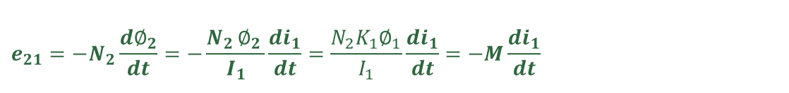
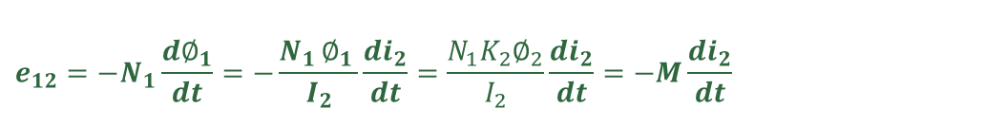




Energy stored in Magnetic Field
Formulae
(to calculate values of following parameters)
$$e=−N\frac{d∅}{dt}$$
$$e_{s}=−L\frac{di}{dt}$$
$$L=\frac{N∅}{I}=\frac{N^{2}}{S}=\frac{N^{2}μ_{0}μ_{r}a}{l}$$
Ø
e_{S}
$$e_{21}=−N_{2}\frac{{d∅}_{2}}{dt}=−\frac{N_{2 }∅_{2 }}{I_{1}}\frac{{di}_{1}}{dt}=\frac{N_{2}K_{1}∅_{1}}{I_{1}}\frac{{di}_{1}}{dt}=−M\frac{{di}_{1}}{dt}$$
$$e_{12}=−N_{1}\frac{{d∅}_{1}}{dt}=−\frac{N_{1 }∅_{1 }}{I_{2}}\frac{{di}_{2}}{dt}=\frac{N_{1}K_{2}∅_{2}}{I_{2}}\frac{{di}_{2}}{dt}=−M\frac{{di}_{2}}{dt}$$
Energy stored $=\frac{1}{2}LI^{2}$ Joule
$M=\frac{N_{1}N_{2}}{S}$= $\frac{N_{1}N_{2}μ_{0}μ_{r}a}{l}$
Energy stored $=\frac{1}{2}LI^{2}$
$$K=\frac{M}{\sqrt{L_{1}L_{2}}}$$

Slide 18
Sample Questions from Magnetic Circuits
Define the following terms related with magnetic circuit. State their units also (2 M each).
Magnetic flux density
Magnetic field strength
Permeability
Magnetomotive force
Reluctance
Permeance
Derive the relation between Magnetomotive force, magnetic flux and reluctance (4M)
Compare Magnetic and Electric Circuit clearly mentioning similarities and dissimilarities (6-8 M)
Explain how flux in air gap can be calculated in case of a magnetic ring having mean diameter of D mtrs with air gap of length as lag mtrs (6M).

Slide 19
Sample theory Questions from Electromagnetic Induction
State faradays Laws of Electromagnetic Induction (4M)
Explain concept of dynamically induced emf (4M)
State Flemings Right hand rule and its application (4M)
Explain self and Mutually Induced EMF (4-6 M)
Define self-Inductance and state the factors affecting it (4M)
Define Mutual Inductance and state the factors affecting it (4M)
Compare self and mutual Inductance (4M)
Derive the expression for coefficient of Coupling (6M)
Derive the expression for energy stored in magnetic field (4M)

